Slide 1
Capstone Project: Car accident severity
October 2020

Slide 2
Introduction
We aim to understand what are the factors affecting severity of car accident.
Data from Seattle Traffic Management has been used in this study to understand the various factors which play part.

Slide 3
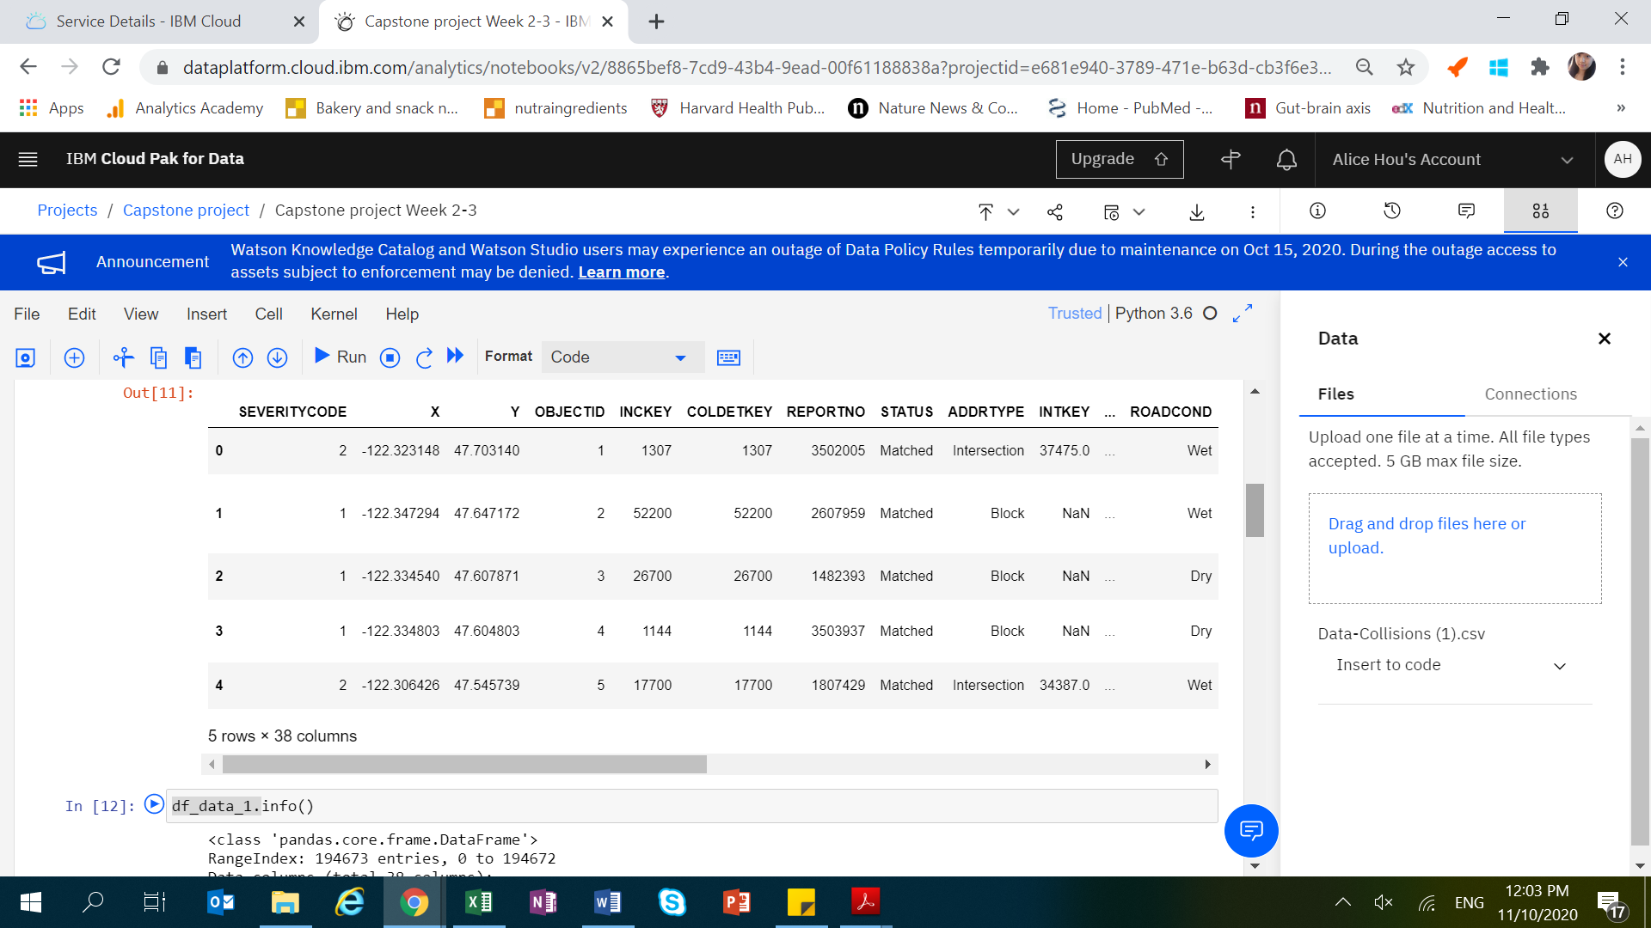
Data Description
The data is provided by SDOT Traffic management division which include all car collisions from 2004 to present in Seattle and has been updated weekly.
The data consists of 38 columns (parameters) and 194673 entries, each entry represent one accident.

Slide 4
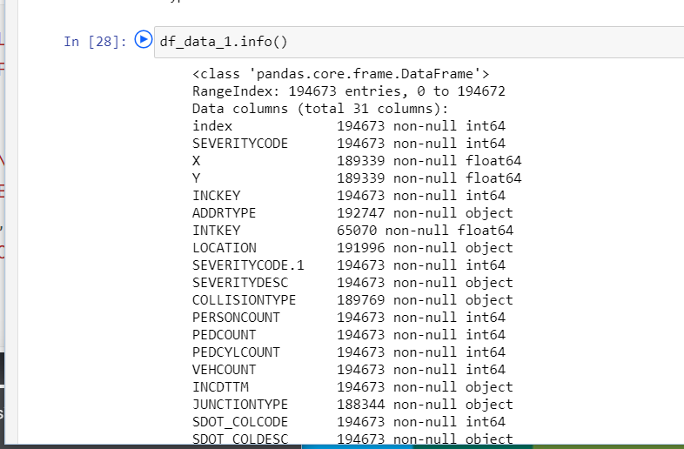
Data clean-up
In the original dataset, there are a number of missing values, redundant columns, missing values and many columns are categorical valuables.
We have carried out a series of clean-up process to render the data suitable for next step analysis.

Slide 5
Results
We visualized the data on the major factors which are likely to play a role in accident severity
Majority of accidents are property damage only collisions.
Number of people involved in accidents range from 0-5 (most) to 60.
Most accidents happen at clear weather condition.
Most accidents happen at daylight or at night with street light on.

Slide 6
Conclusion
Due to the complexity of multiple factors involved, prediction of car accident severity may depend on various machine leaning factors and can be a combined effect include traffic condition, location, road conditions etc.
Through the Capstone project, I have learned to handle a real-world data with complexity. Various techniques from previous modules have been applied and I have benefited tremendously from doing this project.

